Slide 1

Smart Navigation
Sabudh Foundation
Team Members
Sayan Bhattacharjee
Bhuwarth Sarwa
Mentor’s Name
Sukhjit Singh Sehra Sir
Ravi Mittal Sir
Date:- 19-06-2025

Slide 2
Problem Statement
🔹 Research Problem:
Visually impaired individuals face difficulties navigating unfamiliar environments due to a lack of real-time, contextual awareness in current navigation tools.
🔹 Limitations of Current Approaches:
No obstacle or object detection (e.g., stairs, people)
Lack of audio-based environmental description
🔹 Why It Is Challenging:
Requires real-time image/video processing
Needs accurate localization
Must deliver clear, non-visual feedback (e.g., audio/tactile)
Integration of AI and user-friendly interfaces is complex
🔹 What Needs Improvement:
Add object detection and scene narration using AI
Provide adaptive audio guidance for better accessibility
Ensure low-latency, real-time performance in varied environments

Slide 3
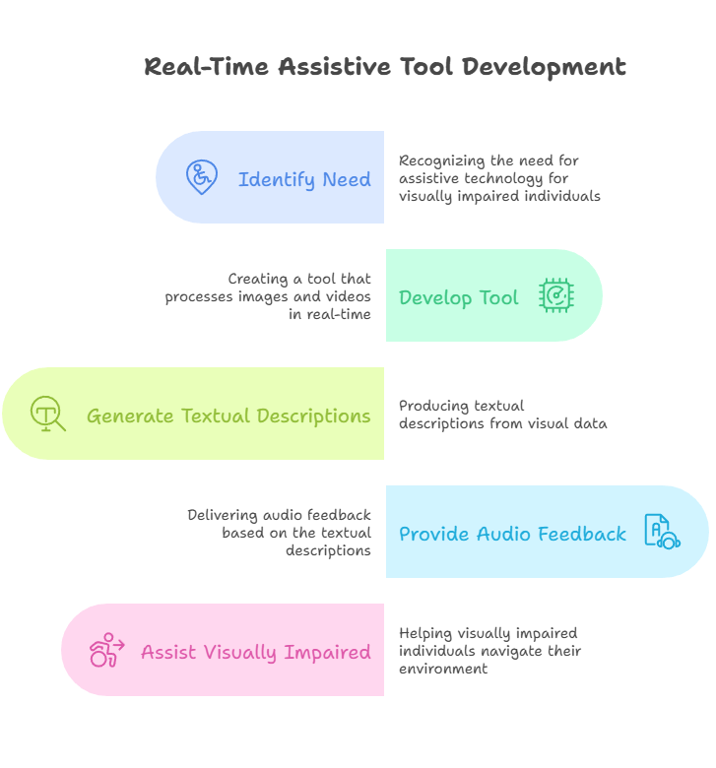
Objective
To develop a real-time assistive tool that generates textual descriptions and audio feedback
from images
and videos for visually impaired individuals.

Slide 4
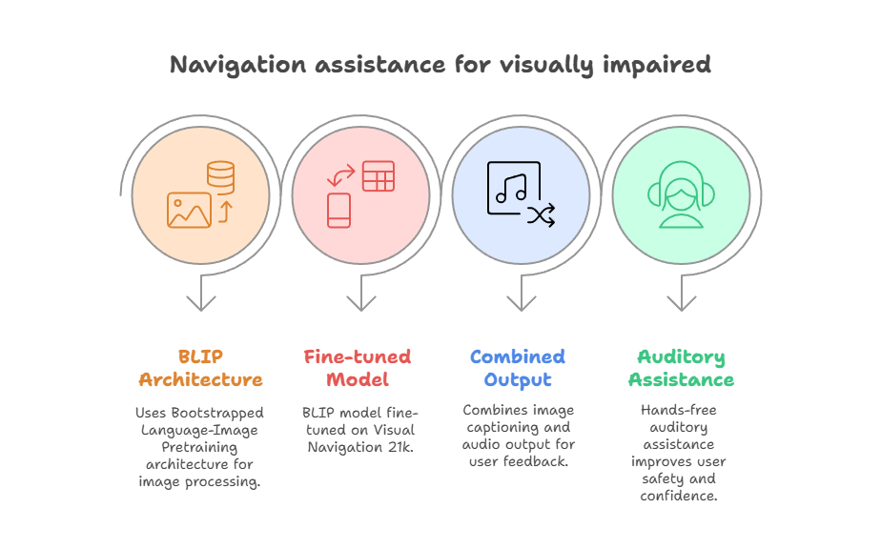
Introduction
A smart navigation powered by a Vision Language Model (VLM) to aid visually impaired individuals in navigating environments with visual feedback.
Combines image captioning and audio output.
Uses BLIP (Bootstrapped Language-Image Pretraining) architecture.
Utilize BLIP model fine-tuned on Visual Navigation 21k for domain-specific captioning.
Provide hands-free auditory assistance to improve user safety and confidence.

Slide 5
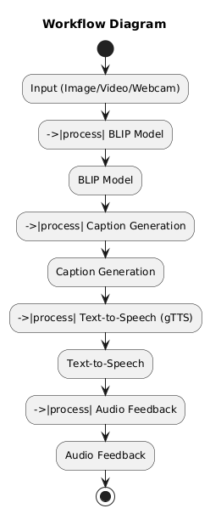
Workflow Diagram

Slide 6
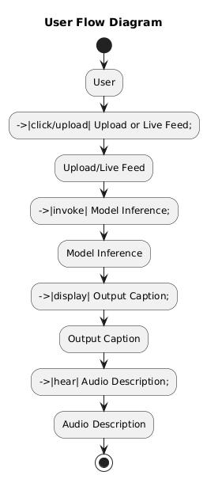
User Flow Diagram

Slide 7
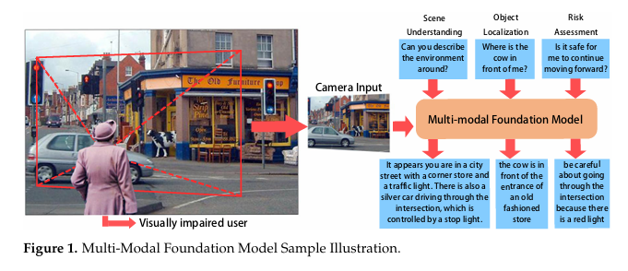
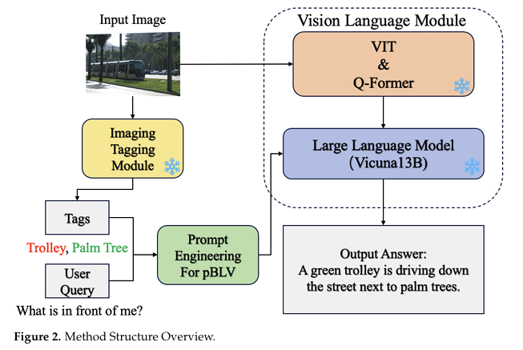
How VLM works

Slide 8
BLIP Model Architecture
BLIP uses a vision encoder (ViT) and text decoder (Transformer) to generate descriptive captions from images.
Pretrained on large datasets.
Fine-tuned on Visual Navigation 21k for domain-specific accuracy.
BLIP integrates a vision encoder (ViT) and language decoder (Transformer)
Generates semantically rich captions using cross-modal understanding.

Slide 9
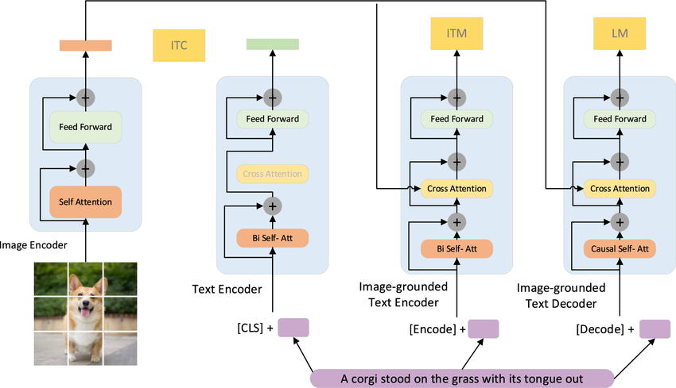
BLIP MODEL ARCHITECTURE
The architecture of the BLIP model involves a multi-modal mixture of encoder-decoder (MED) components, tailored for both understanding and generation tasks.
This includes:
Unimodal Encoder: Independently encodes images and text.
Image-grounded Text Encoder: Incorporates visual data into the text encoding process using cross-attention layers.
Image-grounded Text Decoder: Focuses on generating text from images, employing casual self-attention layers.
The model is pre-trained using three objectives that aim to activate different components of the architecture for efficient learning and performance across various vision-language tasks​.

Slide 10
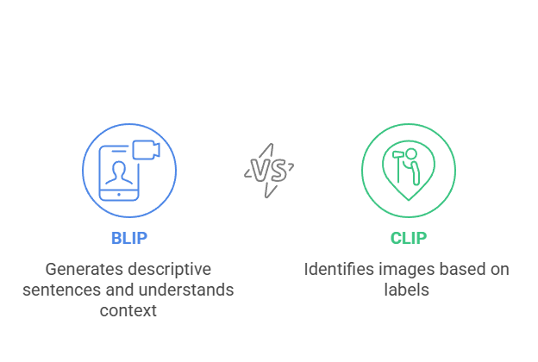
BLIP vs CLIP. Why Use BLIP for Smart Navigation?
We are building a system that helps visually impaired users by describing outdoor scenes in natural language. For this, we need a model that can:
Generate full sentences (e.g., “A man is walking down a street with cars parked beside him”)
Understand contextual relationships between objects (e.g., who is doing what, where)
Offer rich, descriptive captions instead of just identifying categories
🔹 BLIP is ideal because it’s trained specifically for tasks like image captioning and visual storytelling.
🔹 CLIP, on the other hand, is CLIP is trained to align images with text using contrastive learning. It’s powerful for identifying or retrieving images based on a label like “stairs” or “person.” However, it doesn’t generate descriptive sentences—it only tells how well an image matches a caption. This limits its usefulness for applications needing detailed scene understanding.

Slide 11



Dataset Used
Visual Navigation 21k Dataset
Indian Road Street Dataset From Kaggle
Both contains images with detailed descriptions of traffic and road elements.
Useful for training models to describe road environments accurately.

Slide 12
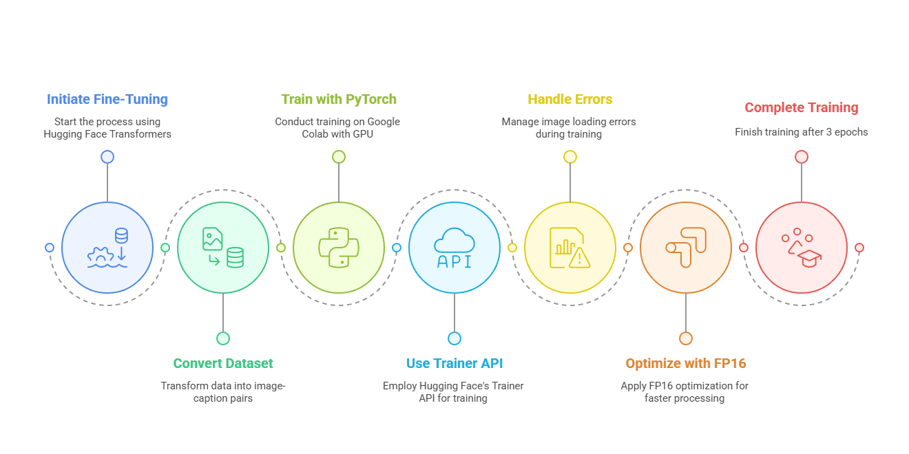
Fine-Tuning BLIP
Fine-tuning Process:
Used Hugging Face Transformers library.
Dataset converted to image-caption pairs.
Trained using PyTorch on Google Colab with GPU support.
Used HuggingFace's Trainer API and custom data collator to preprocess batches.
Handled image loading errors and ensured robust training over batches.
Trained for 3 epochs with FP16 optimization for faster GPU processing in Colab.

Slide 13
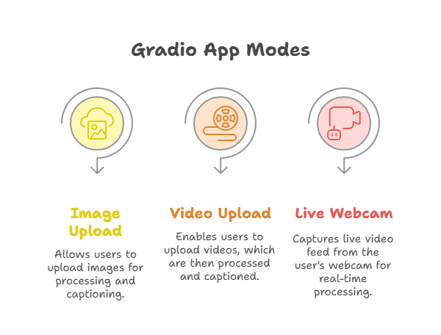
Gradio API Interface
Developed a Gradio app with three modes:
Image upload, Video upload & Live webcam input
Three modes: Upload image, Upload video, or Live webcam feed.
Each mode processes input, generates caption via BLIP, then converts to audio via gTTS.
Gradio Blocks used to organize UI across three tabs with responsive buttons.

Slide 14
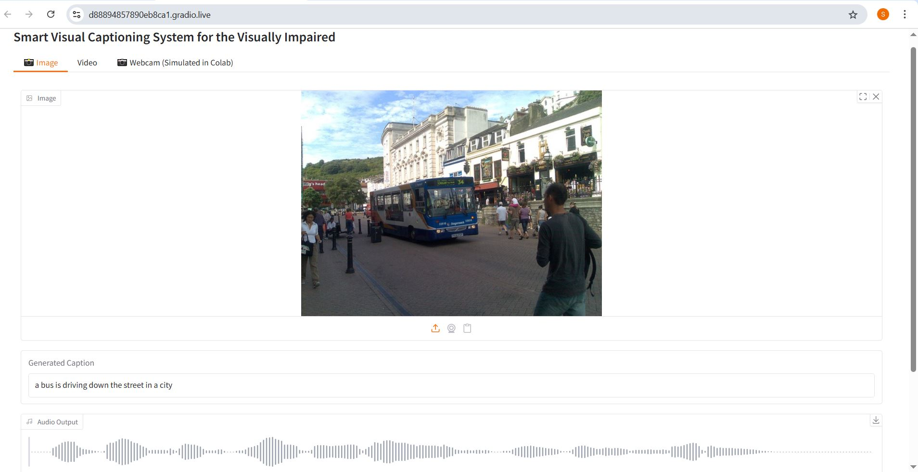

Gradio interface demo

Slide 15
Conclusion
An effective smart navigation system must provide real-time, context-aware guidance that goes beyond traditional GPS. By integrating AI-based object detection and audio feedback, such a system can help visually impaired users navigate outdoor environments safely and independently.
Addressing the current limitations—like lack of obstacle awareness and poor accessibility—will lead to a more inclusive and intelligent navigation solution designed for real-world use.

Slide 16
Future Work
In the future, the smart navigation system can evolve beyond navigation to become a general-purpose visual assistant for the visually impaired. Potential expansions include:
• Integration with wearable devices (e.g., smart glasses, haptic belts) for
hands-free operation.
• Multilingual and personalized voice guidance to suit diverse user needs.
• Text Recognition : Read and summarize text from newspapers,
magazines, signboards, and product labels.
• Financial Assistance: Help interpret cheque books, bills, currency notes,
and price tags.
• Scene and Object Description: Provide detailed narration of
surroundings including people, vehicles, road signs, and hazards.
• Voice Query Support: Allow users to ask questions like “What’s around
me?” or “What does this sign say?”
• Document Reading Mode: Assist in reading letters, menus, bus
schedules, etc., aloud in natural language.

